Slide 1
CSE327 Software Engineering
AKM iqtidar Newaz [IqN]
Lecture - 11

Slide 2
Decorator Design Pattern
Decorator is a structural design pattern that lets you attach new behaviors to objects by placing these objects inside special wrapper objects that contains the behaviors.
Suppose, we have a base object where that base object has some features/properties, and if we want to add more features the we need to use decorator for wrapping the F1 and it is also an object and we can still use a wrapper of decorator for adding new features.
F1
F1 + F2
F1 + F2 + F3 + ... + F_{n}

Slide 3
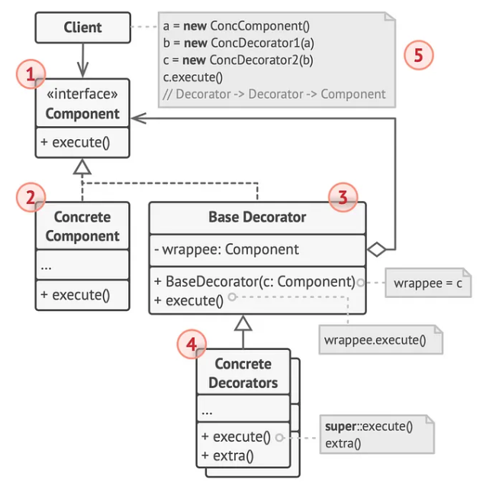
UML Diagram of Decorator Pattern
Component Interface:
Defines the base functionality.
Represented as an interface in UML.
ConcreteComponent Class:
Implement the Component interface.
Provides the core functionality.
Decorator Abstract Class:
Implement the Component interface.
Contains a reference to a Component object.
Adds functionality by delegating calls to the wrapped component
ConcreteDecorator Class:
Extend the Decorator class.
Add specific behavior while maintaining the base functionality.

Slide 4
Basic Example - 1
Consider a Window in a user interface as the Component.
We want to add functionalities like scrollbars or a border without redesigning the window itself.
In this example, SimpleWindow is a Concrete Component that can be decorated with additional features.
WindowDecorator is a decorator that holds a reference to a Window object and delegates the draw operation to it.
ScrollbarWindow is a Concrete Decorator that adds a scrollbar to the window.

Slide 5
Basic Example – 1 (Code)
class WindowDecorator : public Window // Decorator
{
public:
WindowDecorator(Window *window) : window_(window) {}
void draw() override
{
window_->draw(); // Delegate to the component
}
protected:
Window *window_;
};
class ScrollbarWindow : public WindowDecorator // Concrete Decorator
{
public:
ScrollbarWindow(Window *window) : WindowDecorator(window) {}
void draw() override
{
WindowDecorator ::draw(); // Draw the window
drawScrollbar(); // Add scrollbar
}
private:
void drawScrollbar()
{
cout << "Drawing ScrollbarWindow()" << endl;
}
};
#include <iostream>
using namespace std;
class Window // Component
{
public:
virtual void draw() = 0;
virtual ~Window() = default;
};
class SimpleWindow : public Window // Concrete Component
{
public:
void draw() override
{
cout << "Drawing SimpleWindow()" << endl;
}
};
main.cpp
main.cpp

Slide 6
Basic Example – 1 (Code)
int main()
{
cout << "Concrete Component:\n";
Window *simpleWindow = new SimpleWindow();
simpleWindow->draw();
cout << "\nDecorator or Wrapper object:\n";
Window *simpleWindow2 = new SimpleWindow();
Window *scrollbar = new ScrollbarWindow(simpleWindow2);
scrollbar->draw();
}
Output:
Concrete Component:
Drawing SimpleWindow()
Decorator or Wrapper object:
Drawing SimpleWindow()
Drawing ScrollbarWindow()

Slide 7
Basic Example – 2
Let’s consider a text editor application where users can write and format their text.
Initially, the editor offers basic text operations.
However, as an intermediate developer, we want to add functionalities like spell check, grammar check, and auto-correct without altering the core text processing component.
In this example, BasicEditor provides fundamental text editing functionalities.
Decorators like SpellCheckerDecorator add spell-checking capabilities on top of the basic text-writing functionality without changing the BasicEditor class.

Slide 8
Basic Example – 2 (Code)
class EditorDecorator : public TextEditor // Decorator
{
public:
EditorDecorator(TextEditor *editor) : editor_(editor) {}
void write(const string &words) override
{
editor_->write(words); // Delegate to the component
}
protected:
TextEditor *editor_;
};
class SpellCheckerDecorator : public EditorDecorator // Concrete Decorator
{
public:
SpellCheckerDecorator(TextEditor *editor) : EditorDecorator(editor) {}
void write(const string &words) override
{
EditorDecorator::write(words); // Write text
spellCheck(words); // Add spell checking
}
private:
void spellCheck(const string &words)
{
cout << "Performing the spell checking here!!" << endl;
}
};
main.cpp
#include <iostream>
#include <string>
using namespace std;
class TextEditor // Component
{
public:
virtual void write(const string &words) = 0;
virtual ~TextEditor() = default;
};
class BasicEditor : public TextEditor // Concrete Component
{
public:
void write(const string &words) override
{
cout << "Performing Basic Editor Functionality!" << endl;
}
};
main.cpp

Slide 9
Basic Example – 2 (Code)
main.cpp
int main()
{
TextEditor *editor = new BasicEditor();
editor->write(" CSE-327 ");
cout << "\nAfter performing Decorator wrapping:\n";
TextEditor *editor2 = new BasicEditor();
SpellCheckerDecorator *spellChecker = new SpellCheckerDecorator(editor2);
spellChecker->write(" CSE-327 ");
}
Output:
Performing Basic Editor Functionality!
After performing Decorator wrapping:
Performing Basic Editor Functionality!
Performing the spell checking here!!

Slide 10
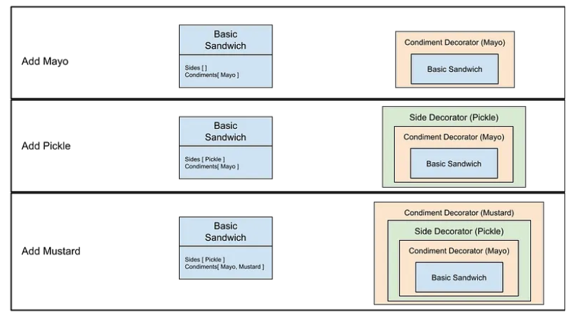
Example – 3 (Order Sandwich)
Suppose we’re building a sandwich shop where the user has the ability to choose the base of the sandwich, then add sides and condiments onto it.
The base of the sandwich has a basic version, which uses regular bread and meat, where as the deluxe version uses organic bread and meat, along with cheese and lettuce in it.
After the customer choose the base, and selects the additional sides and condiments, the sandwich shop will return the total cost and the various ingredients that went into sandwich.

Slide 11
Example – 3 (Code)
#pragma once
#include <string>
#include <iostream>
using namespace std;
class SandwichOrder // Component
{
public:
virtual int GetCost() const = 0;
virtual string GetIngredient() const = 0;
};
#pragma once
#include "sandwichOrder.h"
class BasicSandwich : public SandwichOrder // Concrete Component
{
public:
int cost = 5;
int GetCost() const override
{
return cost;
}
string GetIngredient() const override
{
return "Basic Bread and Meat";
}
};
sandwichOrder.h
basicSandwich.h

Slide 12
Example – 3 (Code)
#pragma once
#include "sandwichOrder.h"
class Decorator : public SandwichOrder // Decorator
{
public:
SandwichOrder *order_;
Decorator(SandwichOrder *order) : order_(order) {}
int GetCost() const override
{
return order_->GetCost();
}
string GetIngredient() const override
{
return order_->GetIngredient();
}
};
#pragma once
#include "sandwichOrder.h"
class DeluxeSandwich : public SandwichOrder // Concrete Component
{
public:
int cost = 8;
int GetCost() const override
{
return cost;
}
string GetIngredient() const override
{
return "Organic Bread, Organic Meat, Cheese, veggie";
}
};
decorator.h
deluxeSandwich.h

Slide 13
Example – 3 (Code)
#pragma once
#include "decorator.h"
class CondimentDecorator : public Decorator
{
public:
string condiment_;
int cost_ = 1;
CondimentDecorator(string condiment, SandwichOrder *order) : condiment_(condiment), Decorator(order) {}
int GetCost() const override
{
return cost_ + Decorator ::GetCost();
}
string GetIngredient() const override
{
return condiment_ + " " + order_->GetIngredient();
}
};
#pragma once
#include "decorator.h"
class SideDecorator : public Decorator
{
public:
string side_;
int cost = 2;
SideDecorator(string side, SandwichOrder *order) : side_(side), Decorator(order) {}
int GetCost() const override
{
return cost + Decorator::GetCost();
}
string GetIngredient() const override
{
return side_ + " " + order_->GetIngredient();
}
};
sideDecorator.h
condimentDecorator.h

Slide 14
Example – 3 (Code)
#include "condimentDecorator.h"
#include "sideDecorator.h"
#include "deluxeSandwich.h"
#include "basicSandwich.h"
#include <iostream>
using namespace std;
void ServeOrder(SandwichOrder *order)
{
std::cout << "Total Cost: " << order->GetCost() << std::endl;
std::cout << "Ingredients: " << order->GetIngredient() << std::endl;
}
int main()
{
SandwichOrder *sandwich1 = new DeluxeSandwich;
SandwichOrder *decorated1 = new CondimentDecorator("mayo", sandwich1);
SandwichOrder *decorated2 = new SideDecorator("pickle", decorated1);
SandwichOrder *decorated3 = new CondimentDecorator("mustard", decorated2);
SandwichOrder *final_order = new SideDecorator("onion", decorated3);
ServeOrder(final_order);
return 0;
}
main.cpp
Output:
Total Cost: 14
Ingredients: onion mustard pickle mayo Organic Bread, Organic Meat, Cheese, veggie

